Slide 1
Year 6 Transition Project

Slide 2
Bonjour et bienvenue!
Hello and welcome!

Slide 3
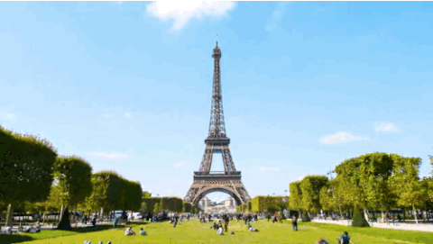
Aujourd’hui nous allons visiter la France…
Today we are going to visit France…

Slide 4
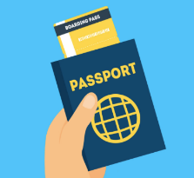
What is the fastest way to travel from London to France?
Eurostar in numbers
135
Journey time from London
to Paris in minutes
80
Length of each Eurostar
train in metres
208
The train’s record speed in mph
890,000
Number of croissants and pastries served each year!
OK, Year 6, it’s nearly time to pack your passport and suitcase and head to Paris…

Slide 5
But first let’s see how much you know about France already with this quick-fire quiz!
Just click on the number to reveal each question

Slide 6
1. What is the capital of France?
Un
1
Lyon
Paris
Berlin
Madrid

Slide 7

2. What is the currency of France?
Deux
2
Dollar
Sterling
Franc
Euro

Slide 8
3. What’s the highest mountain in France?
Trois
3
Mont Blanc
Matterhorn
Kilimanjaro
Mount Olympus

Slide 9
4. What’s the longest river in France?
Quatre
4
Rhine
Seine
Loire
Thames

Slide 10
5. What food is France famous for?
Cinq
5
Sushi
Pasta
Cheese
Pizza

Slide 11
6. What drink is France famous for?
Six
6
Ouzo
Beer
Lemonade
Wine

Slide 12
7. Which of these is a famous Paris landmark?
Sept
7
Sears Tower
Eiffel Tower
Empire State Building
Fernsehturm

Slide 13
8. Which Disney film was set in France?
Huit
8
Cinderella
The Little Mermaid
Ratatouille
Snow White

Slide 14
9. What colours are on the French flag?
Neuf
9
Green, black and yellow
Red and green
Red, white and blue
Blue and yellow

Slide 15
10. Which of these words we use in English comes from French?
Dix
10
Fiasco
Paella
Kindergarten
Rendezvous

Slide 16
Well done! You’ve learned loads of interesting facts and also the numbers from 1-10
You’ve also learned the colours of the French flag (le tricolore) – blue, white and red!

Slide 17
But do you know how to say blue, white and red in French?
Bleu
Blanc
Rouge

Slide 18
And which colours do you think these are?
Vert
Jaune
Orange
Noir

Slide 19
Now try and guess what these French words might mean…
Montagne
Rivière
Mer
Ville
Mountain
River
Sea
Town/city

Slide 20
OK, now let’s see if you can work out where some of France’s most famous mountains, rivers, seas and towns are on a map!! Good luck…

Slide 21
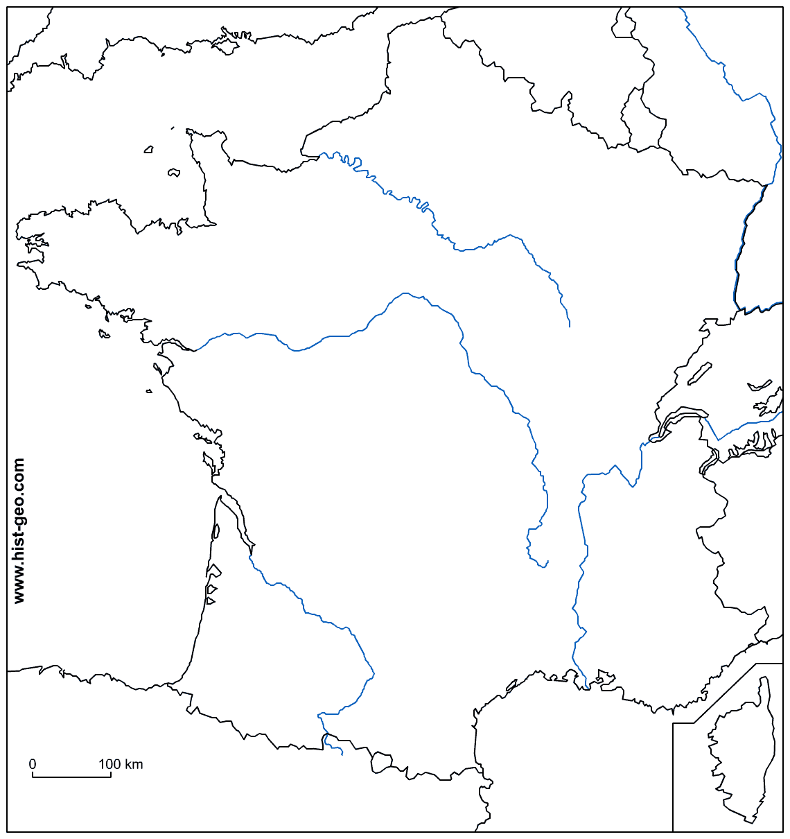
Fill in the French blanks!
Use your knowledge, an atlas/map or the internet to help you to label the following information on this map of France. Label next to the symbol as indicated…
LES MONTAGNES:
Les Alpes, Les Pyrénées
LES RIVIÈRES: La Seine, Le Rhône, La Loire, La Garonne
LES MERS: La Méditerranée,
L’Océan Atlantique, La Manche
LES VILLES: Paris, Lyon, Marseille,
Strasbourg, Bordeaux

Slide 22
How did you get on?
Let’s find out…

Slide 23
A few French facts for you…
La Manche is the French name for
the English Channel
Mont Blanc
is in the Alps
Bordeaux is famous for making wine
The Pyrenees are on the border of France
and Spain
LES MONTAGNES:
Les Alpes
Les Pyrénées
LES RIVIÈRES:
La Seine
Le Rhône
La Loire
La Garonne
LES MERS:
La Méditerranée
L’Océan Atlantique
La Manche
LES VILLES:
Paris
Lyon
Marseille
Strasbourg
Bordeaux

Slide 24
And finally…
We are really looking forward to teaching you loads of new
things about France at Hewens College in September, but before then we need you to do one little task please:
Can you make a list of 20 French words that we use all the time
in English? Remember ‘rendezvous’ from the quiz just now? Well, there are lots of others. So get your thinking caps on and bring
your word list with you in September! À bientôt!!!

